Slide 1


Introduction to Social Buzz

Slide 2


Today's agenda
Project recap
Problem
The Analytics team
Process
Insights
Summary

Slide 3

Over the course of the three-month initial project, our objectives were to conduct a comprehensive audit of Social Buzz's big data practices, provide recommendations for a successful Initial Public Offering (IPO), and analyze content categories to identify the top 5 with the largest aggregate popularity. The deliverables included an audit report detailing current big data practices, IPO preparation recommendations, and a presentation highlighting the top content categories.
Project Recap

Slide 4

Problem
The presentation aims to address Social Buzz's need for external expertise by providing insights and recommendations in three key areas: big data practices audit, IPO preparation, and content category analysis.

Slide 5



Andrew Fleming
Chief Technical Architect
The Analytics team
Marcus Rompton
Senior Principle
Yuvashri B
Data Scientist

Slide 6
Data Collection
Process
1
2
Clean Data
3
Create data model
Export the data in required format
4
5
Analyse and gather insights

Slide 7
Insights
16 Unique categories
Highest Score
Animal
Lowest Score Technology
Jan and may with highest number of posts

Slide 8
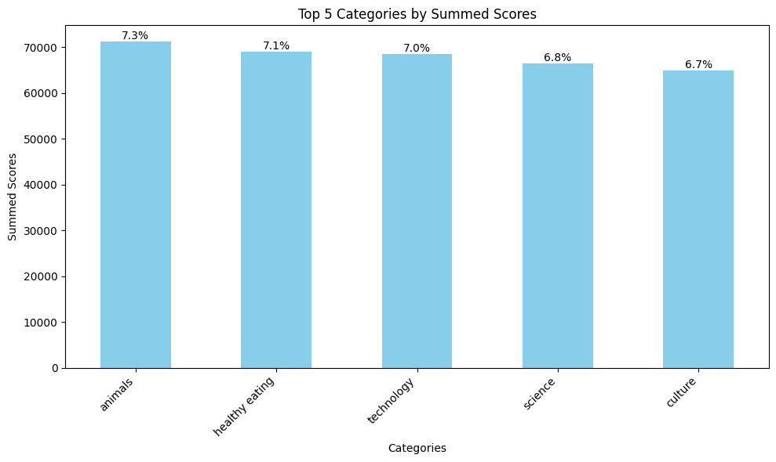
Top 5 Categories

Slide 9
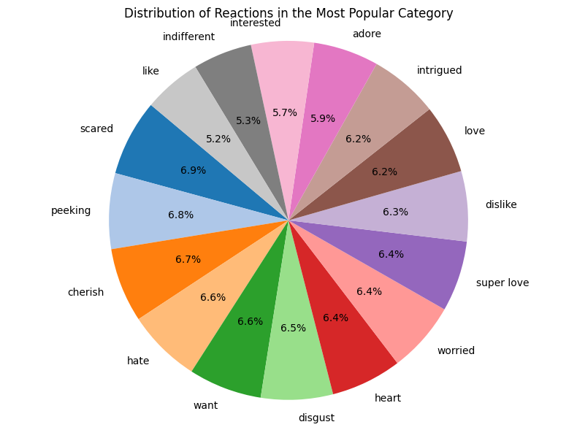
How many reactions are there to the most popular category?

Slide 10
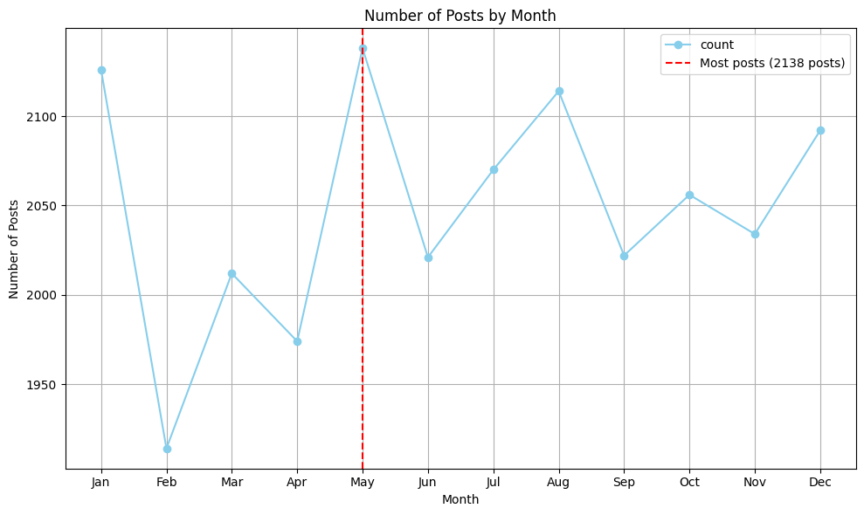
What was the month with the most posts?

Slide 11
Summary
The top 5 categories by summed scores are as follows: “Animals” (71242), “Healthy Eating” (69067), “Technology” (68521), “Science” (66549), and “Culture” (64952).
Positive emotions such as "Adore," "Super Love," and "Heart" collectively account for approximately 18.8% of emotional responses.
Negative emotions, including "Hate," "Disgust," and "Scared," make up around 18.3% of emotional responses.
Neutral emotions like "Indifferent" and "Interested" represent about 11% of emotional responses.
The highest number of posts (2138) occurred in May, as indicated by a red dashed line. The post counts fluctuate throughout the months, with significant drops in February and October and peaks in May and December

Slide 12
Thank you!
ANY QUESTIONS?

